Slide 1
TASK-4
K. Deekshitha

Slide 2
Project Overview
Project Title: Superstore Sales Data Analysis
Objective: To analyze Superstore sales data and generate business insights using data cleaning, exploratory data analysis, dashboarding, and statistical validation techniques.
Dataset Used: Superstore Sales Dataset
Key Columns:
Ship Mode • Segment • Country • City • State • Region • Category • Sub-Category
• Sales • Quantity • Discount • Profit
Project Workflow:
Task 1 → Data immersion and wrangling
Task 2 → Exploratory Data Analysis
Task 3 → Dashboard Development
Task 4 → Statistical Validation & Storytelling

Slide 3
TASK1:Data Immersion and Wrangling
Objective: To understand, clean, and prepare the dataset for analysis.
Activities Performed:
• Data Profiling
• Missing Value Detection
• Duplicate Checking
• Data Type Validation
• Outlier Detection
• Feature Engineering
• Data Dictionary Creation
Skills Demonstrated:
• Data Cleaning
• Data Wrangling
• Data Validation
• Feature Engineering
Output: • Cleaned Dataset • Data Dictionary • Quality-Checked Data

Slide 4
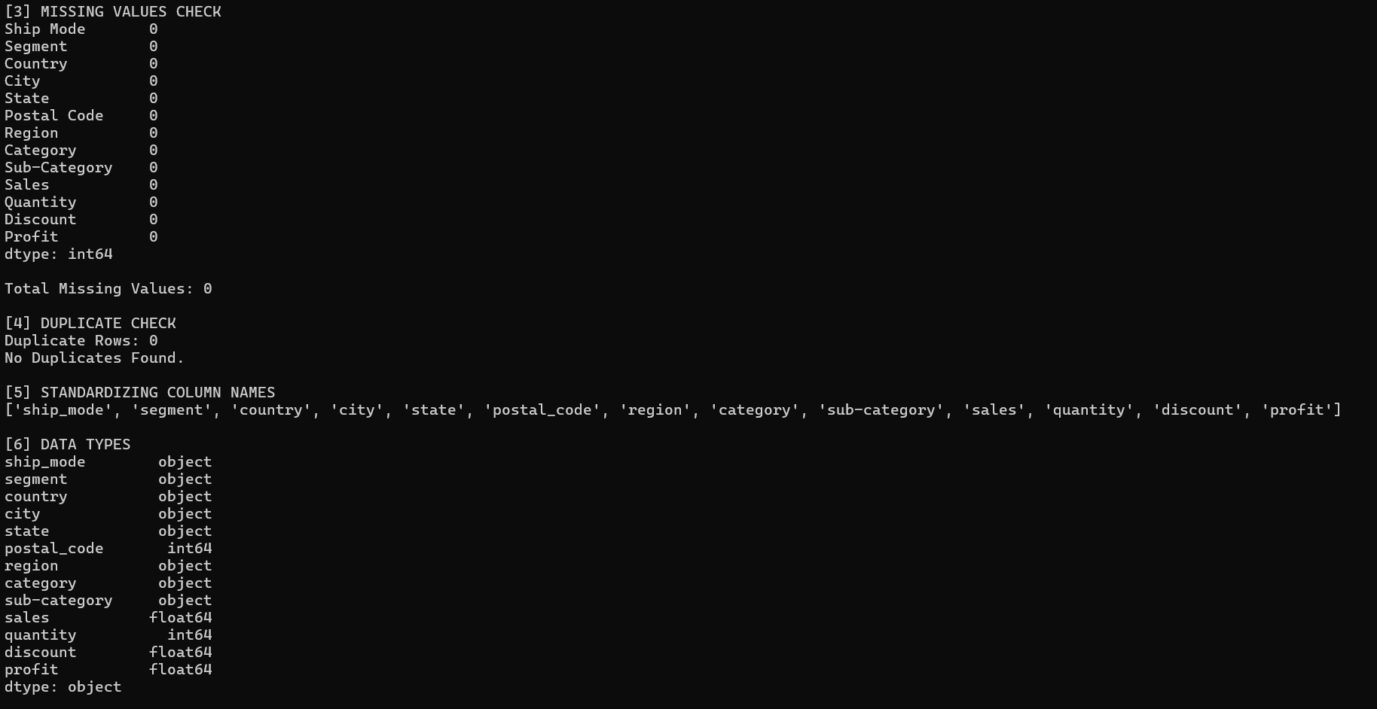
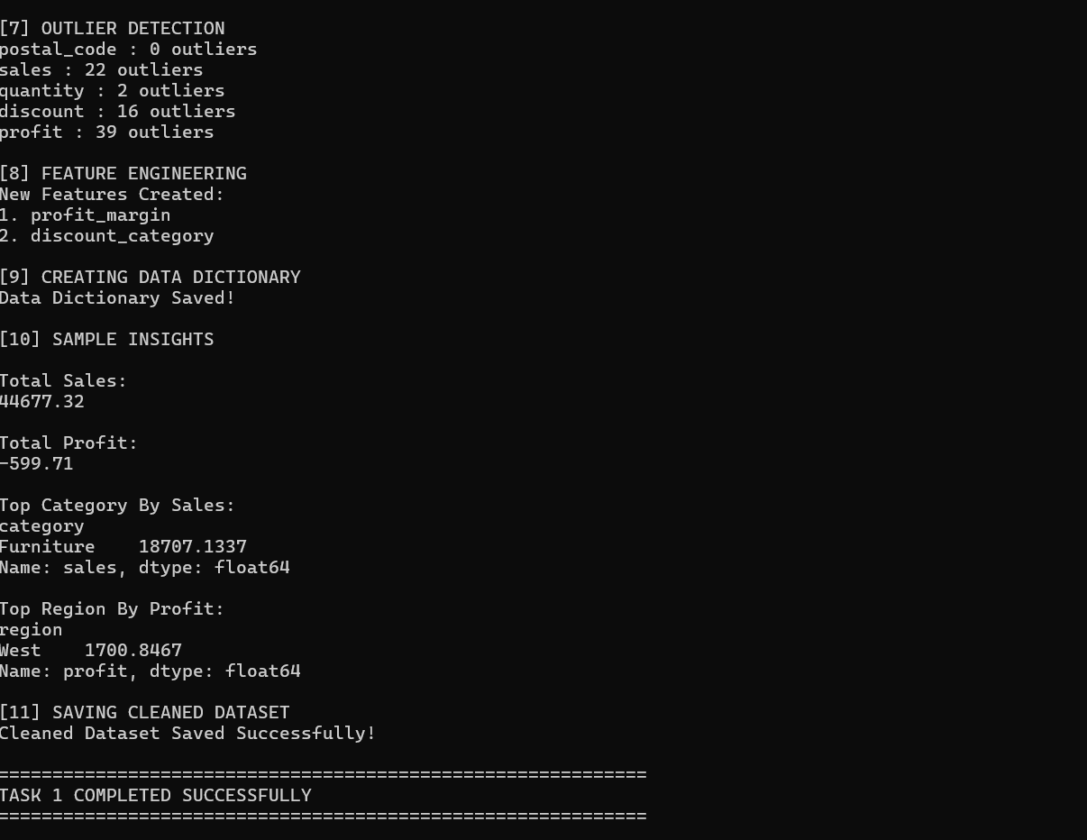

Slide 5
Task 2: Exploratory Data Analysis & Bussiness Intelligence
Objective: To identify sales patterns, profit trends, and business opportunities.
Activities Performed:
• Sales Analysis
• Profit Analysis
• Region Analysis
• Category Analysis
• State Analysis
Skills Demonstrated:
• Exploratory Data Analysis
• Data Visualization
• Business Intelligence
Output:
• Sales Distribution • Profit Distribution • Region-wise Sales
• Category-wise Sales • Category-wise Profit • Top 10 States by Sales

Slide 6
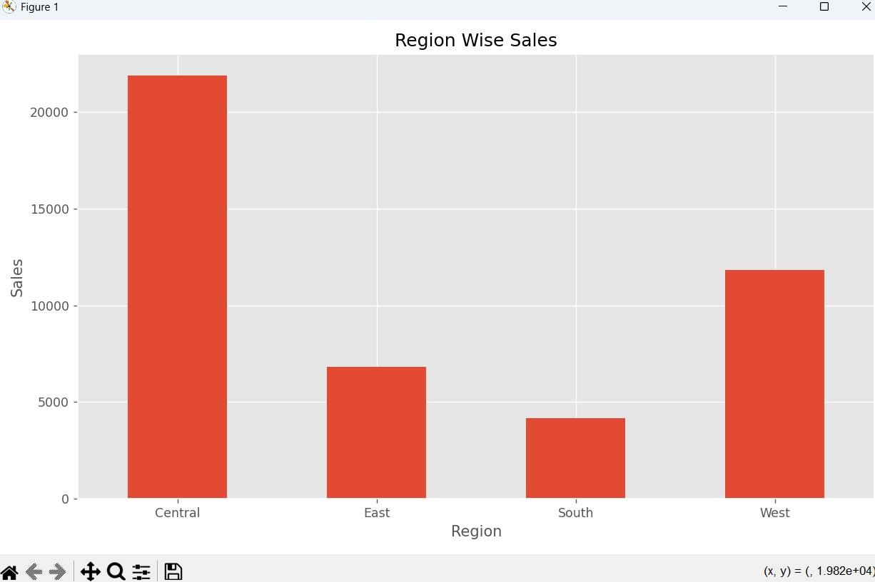
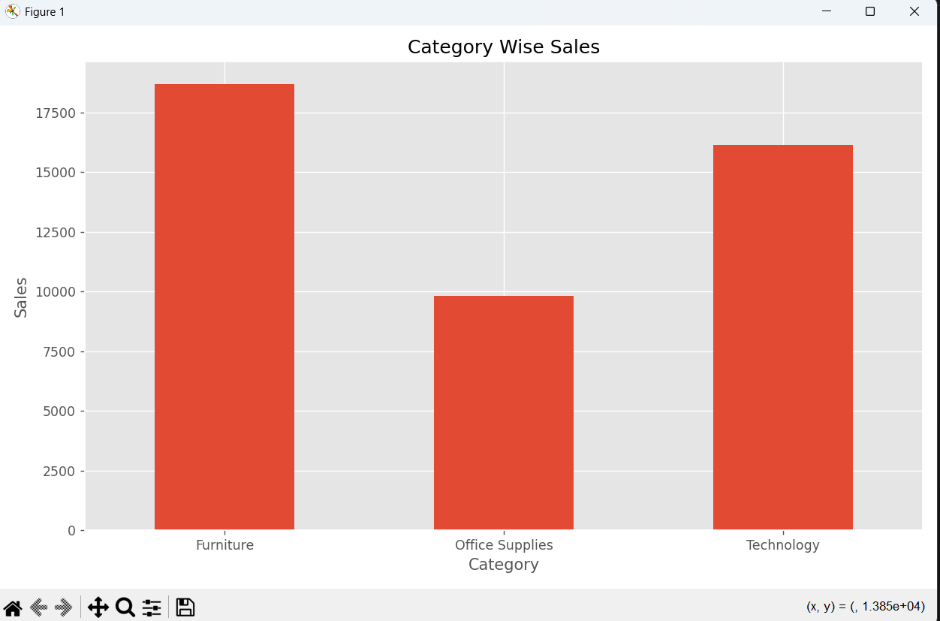

Slide 7
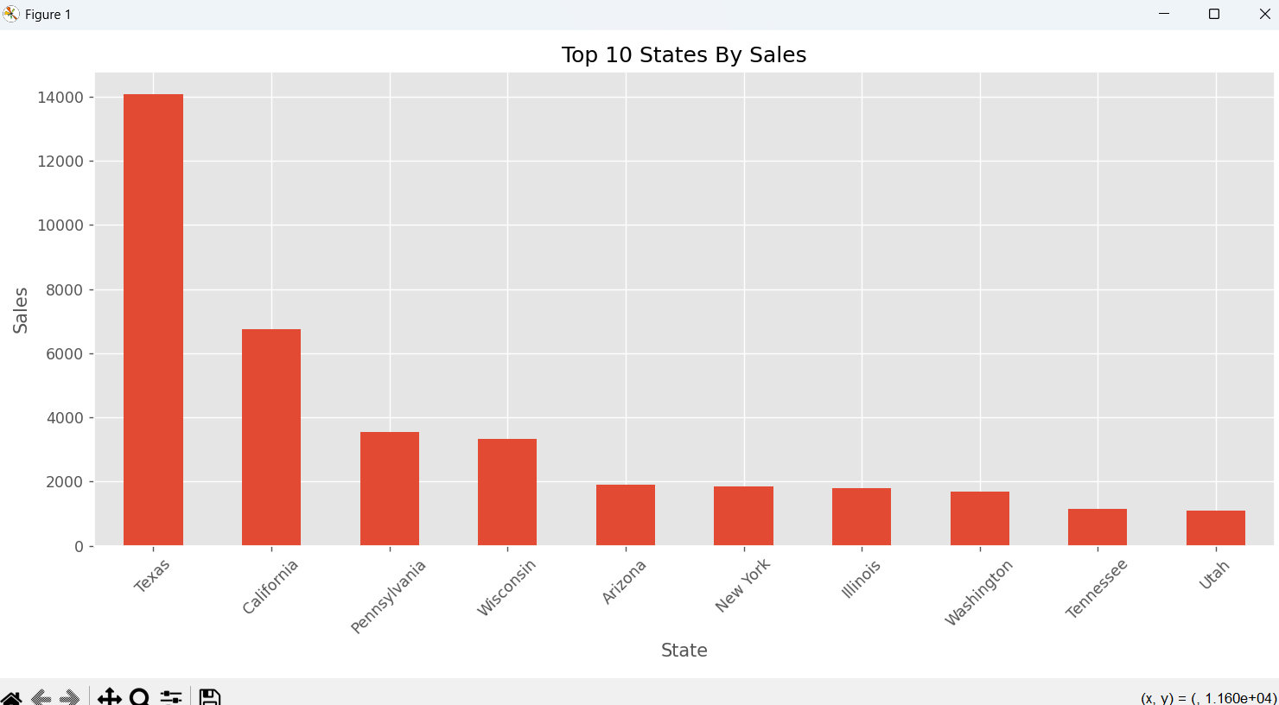
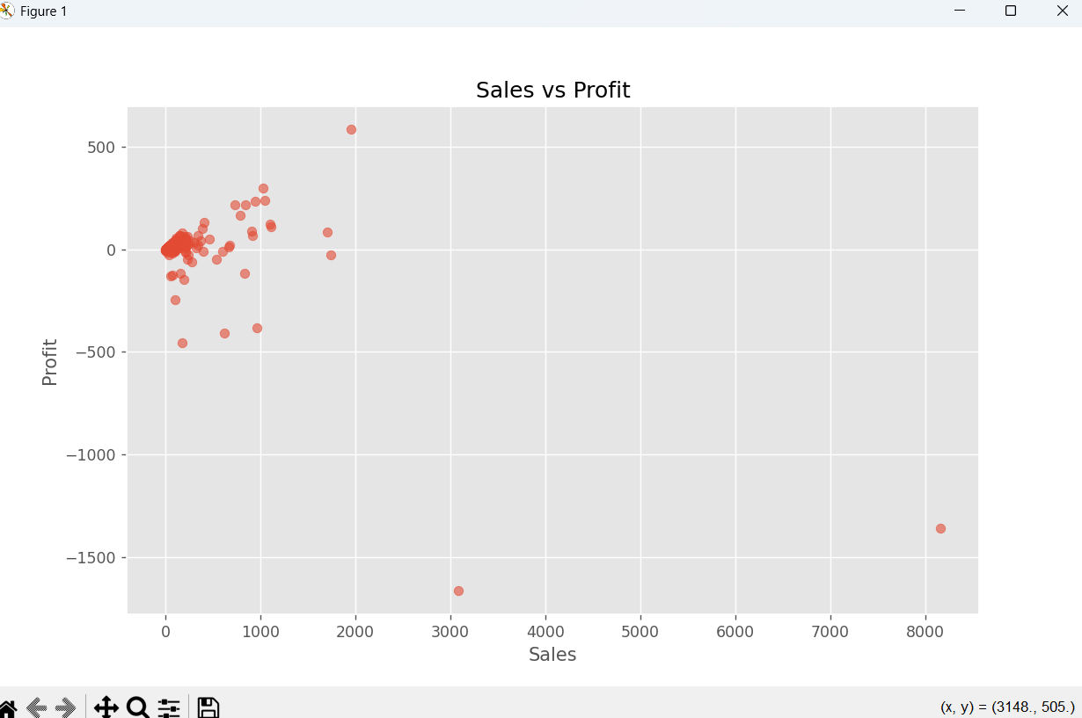

Slide 8
TASK 3: Deep-Dive Analysis & Interactive Dashboarding
Objective: To create interactive dashboards for monitoring business performance.
Activities Performed:
• KPI Generation
• Region Dashboard
• Category Dashboard
• Segment Dashboard
• Profit Dashboard
Skills Demonstrated:
• Dashboard Design
• KPI Analysis
• Business Reporting
Output:
• Interactive Region Dashboard • Interactive Category Dashboard • Interactive Segment Dashboard • Interactive Profit Dashboard

Slide 9
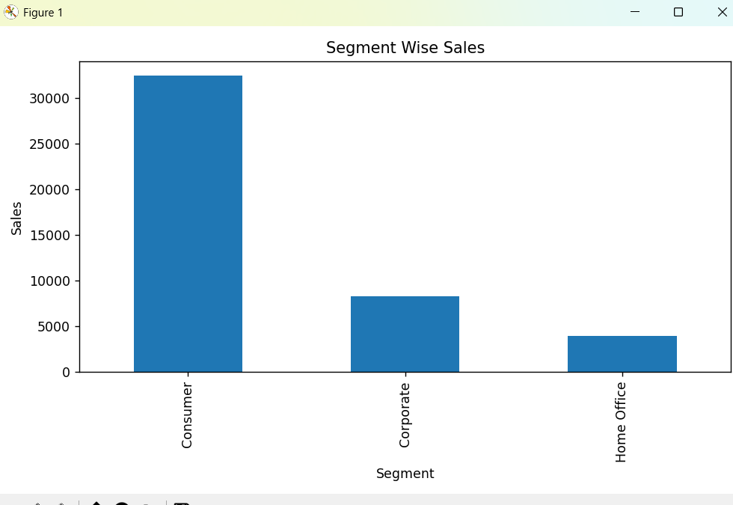
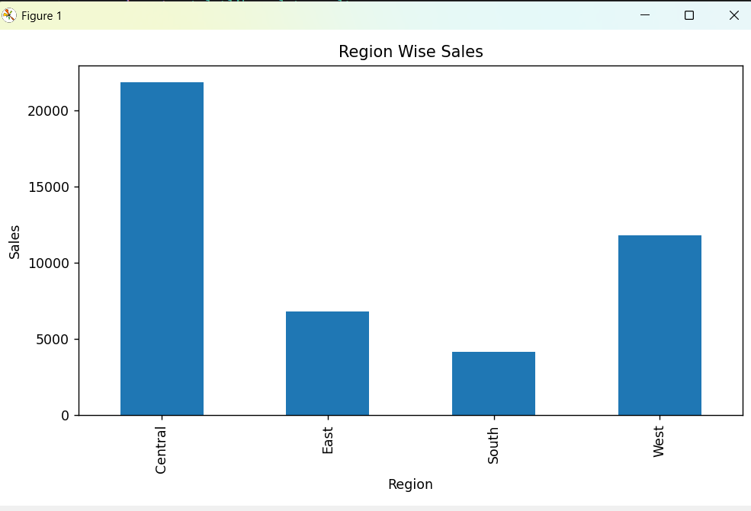
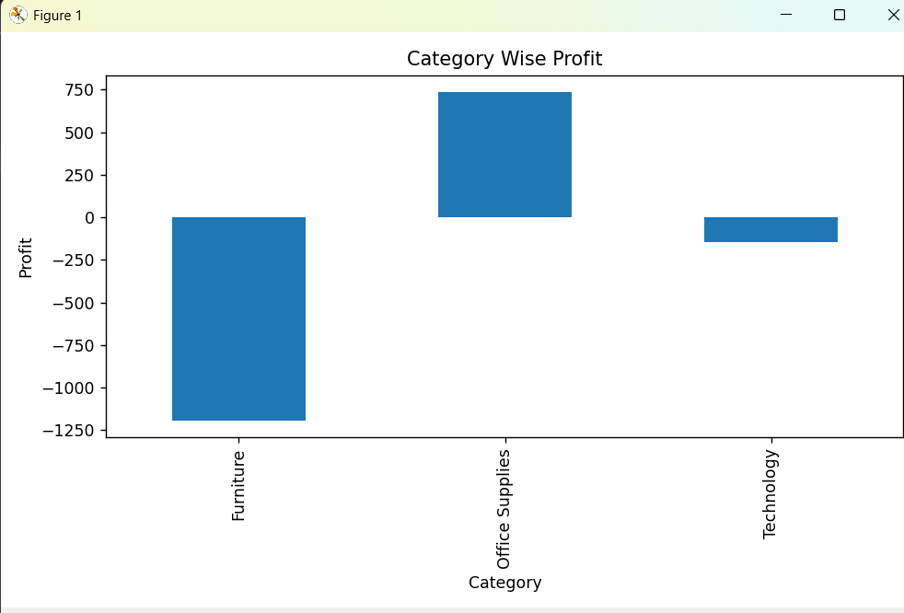

Slide 10
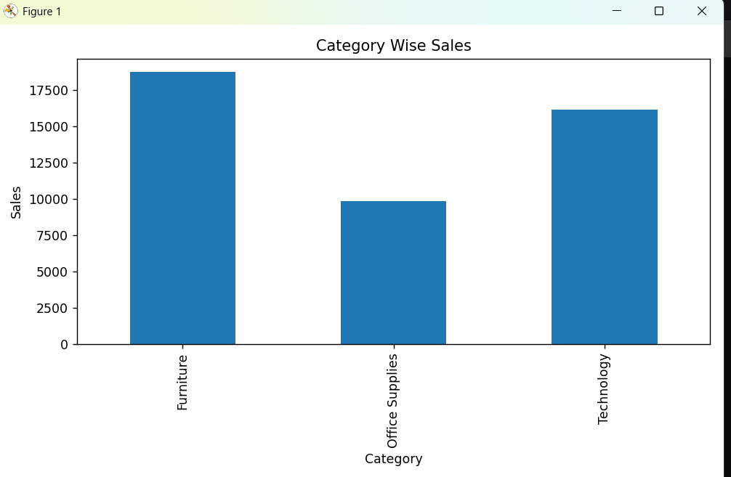
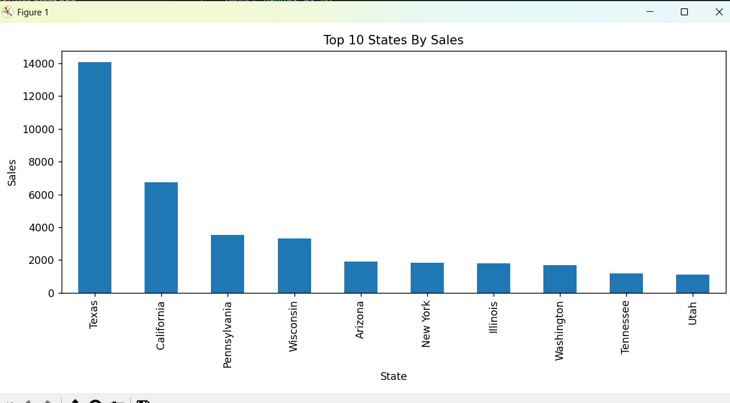

Slide 11
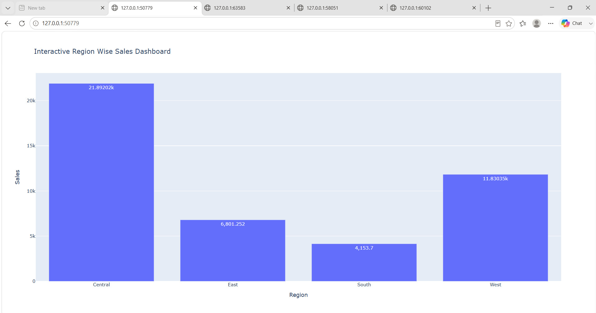
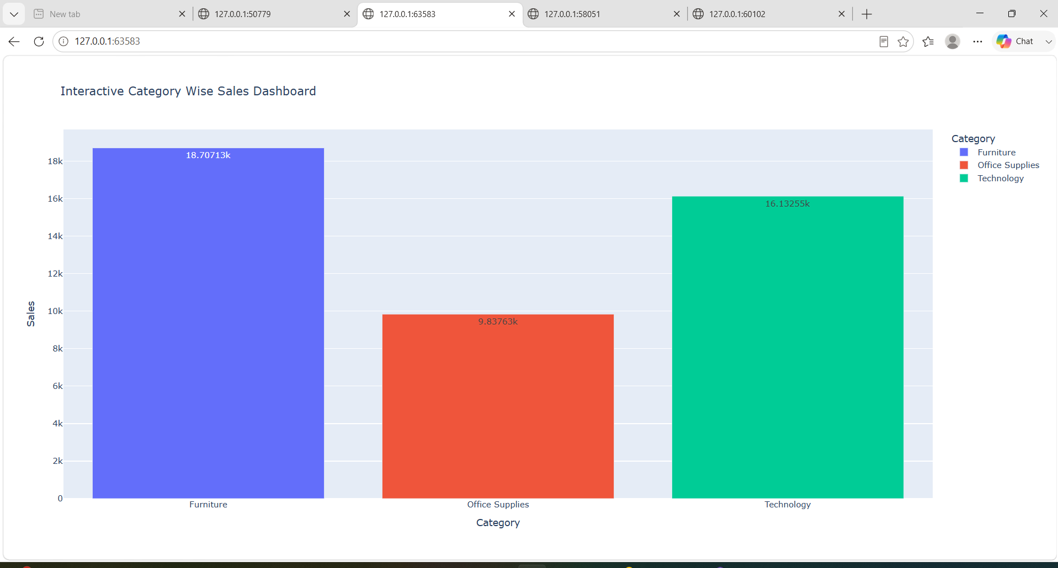

Slide 12
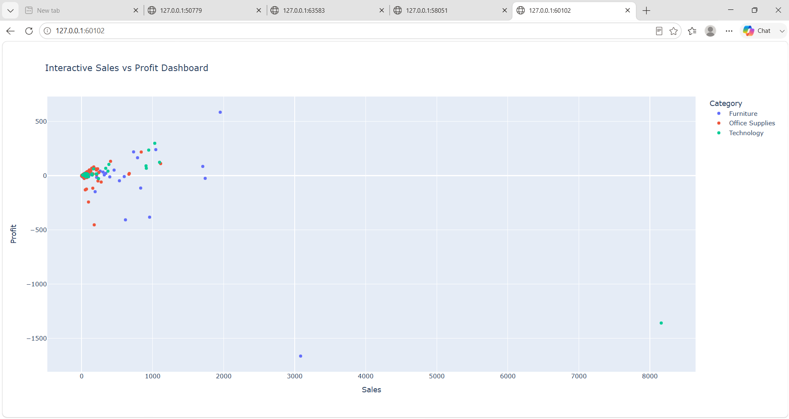
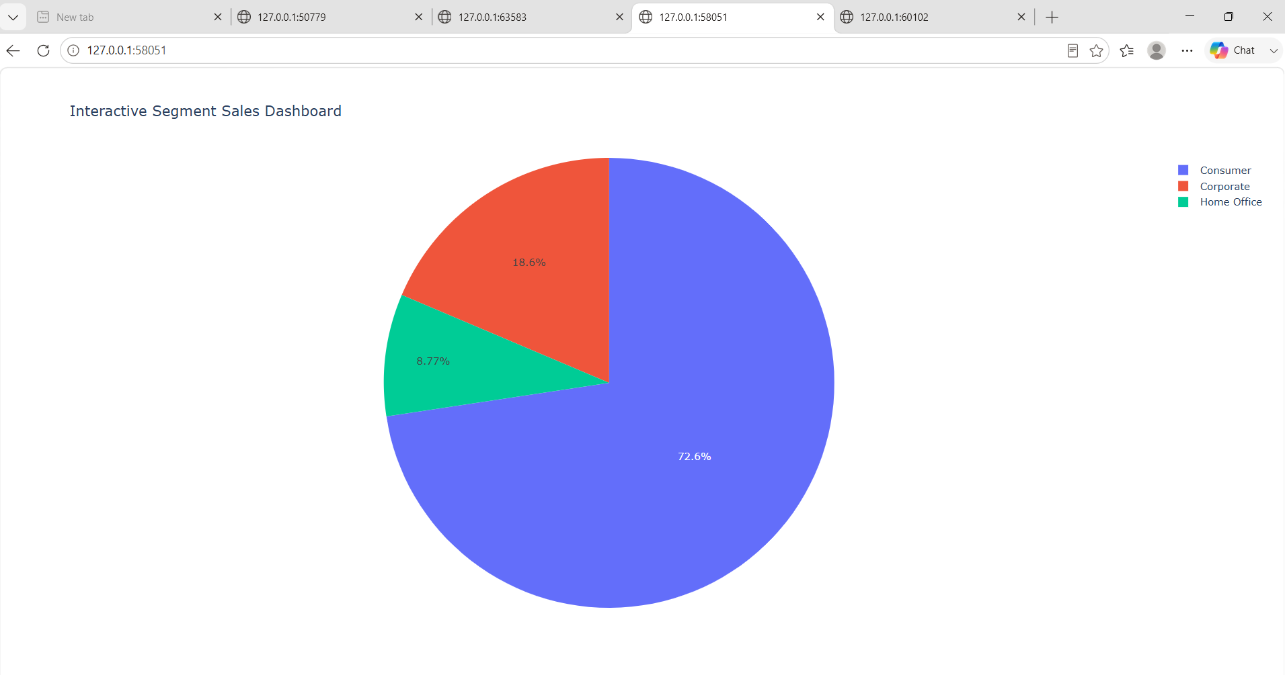

Slide 13
Key Business Insights
Insights:
• Sales varied significantly across regions
.• Certain categories generated higher profits.
• Customer segments showed different purchasing patterns.
• Discounts influenced profitability.
• Regional opportunities for expansion were identified.
Recommendations:
• Focus on high-performing regions.
• Improve profitability in low-margin categories.
• Optimize discount strategies.
• Target profitable customer segments.

Slide 14
Hypothesis Testing
Objective:
Compare the average profit of the Technology and Furniture categories.
Null Hypothesis (H₀):
No significant difference in average profit between the two categories.
Alternative Hypothesis (H₁):
Significant difference in average profit between the two categories.
Statistical Test:
Independent Samples t-test (Welch's t-test)
Significance Level: α = 0.05
Results:
T-Statistic: ______
P-Value: ______
Conclusion:
If p < 0.05 → Reject H₀ (Significant difference exists).
If p ≥ 0.05 → Fail to reject H₀ (No significant difference exists).

Slide 15
Skills Required
Technical Skills
Python
Pandas
NumPy
Matplotlib
Seaborn
Streamlit
Analytical Skills:
Data Cleaning
EDA
Dashboard Development
Statistical Validation
Business Intelligence
Data Storytelling

Slide 16
Project Deliverables
Files Created:
• Cleaned Dataset
• Data Dictionary
• Analysis Reports
• Dashboards
• Portfolio App
• Internship Summary
• Final Presentation
GitHub Repository:
TASK1: https://github.com/deekshithakaya-arch/Apexplanet-task_1
TASK2: https://github.com/deekshithakaya-arch/Task2-EdA-Business-Intelligence/tree/main
TASK3: https://github.com/deekshithakaya-arch/Task3-DeepDive-Analysis-Interactive-Dashboarding/tree/main

Slide 17
Conclusion
This internship provided hands-on experience in the complete data analytics process, including data cleaning, exploratory data analysis, dashboard development, data storytelling, and statistical validation. By analyzing the Superstore Sales Dataset, I gained valuable insights into sales performance, profitability, customer segments, and regional trends. The project enhanced my skills in Python, Pandas, NumPy, Matplotlib, Seaborn, and Streamlit while strengthening my analytical and problem-solving abilities. Overall, this experience improved my understanding of how data-driven insights can support effective business decision-making and real-world problem solving.

Slide 18


